Slide 1
Autonomous Flag Finder
Burnout Squad
Jeremiah McCutcheon: Project Manager
David Koblah: Hardware Design
Michael Bates: Software Design

Slide 2
System Description
This system is an autonomous robot designed to locate, identify and retrieve flags inside a room or maze.
It will utilize a camera and proximity sensors to navigate its environment.
The camera will wirelessly communicate with a computer in order to identify flags and retrieve them.
A microcontroller will control the movement of the tank, proximity sensors and servo motors to rotate the camera or retrieve the flags.
David Koblah

Slide 3
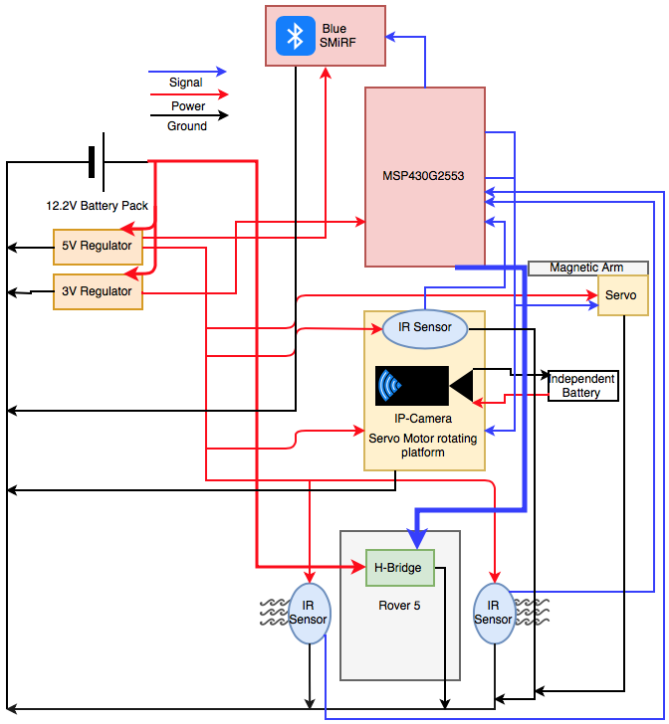
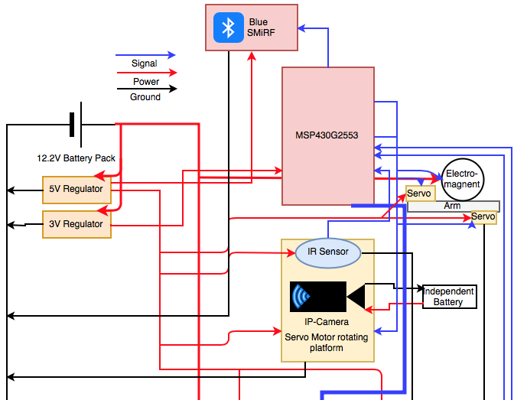
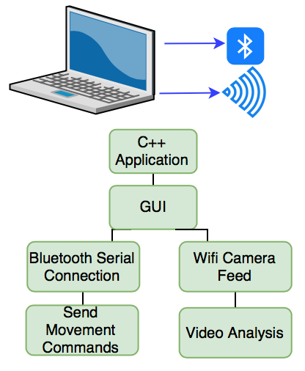
System Diagram
Ultra sonic Sensor
Ultra sonic Sensor
Jeremiah McCutcheon

Slide 4
Division of labor
Jeremiah: Bluetooth serial communication on Mac, Tank movement, Image Processing
David: H-Bridge Implementation, Blue SMiRF receiving communication, Servo arm and Electromagnet interface, Servo and Video Camera interface
Michael: IR sensor implementation, Ultrasonic Sensor implementation, Movement commands, UART Interrupts
Jeremiah McCutcheon

Slide 5
Safety Concerns
Our primary safety concern this week has been managing the 9.6V battery to avoid any fires and over volting microcontroller circuits. We may also add a warning signal to our design to prevent fellow lab users from running into the rover.
David Koblah

Slide 6
Last Week’s Deliverables
Jeremiah
Establish full manual control of rover via bluetooth C++ App✅
Begin IP camera integration❌
Prototype user interface✅
David
Integrate Bluetooth control into User Interface✅
Assist with writing code for image processing❌
Prepare motor arm code and hardware ✅
Michael
Liaison with lab tutor to install router for IP camera✅
Complete IR Sensor interface✅
Research/Order Flags ✅
Complete Budget Request✅
Michael Bates

Slide 7
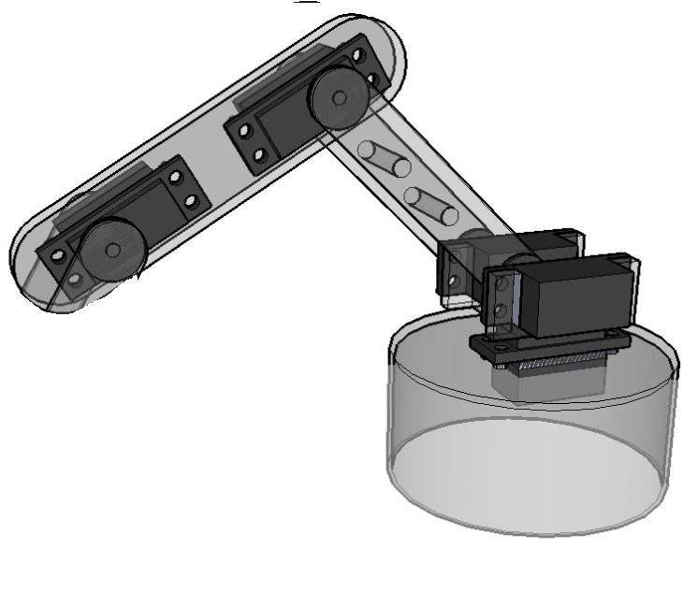
Robot Arm Concept
1st Servo to control up-down motion
2nd Servo to control rotation
Base to allow rotation
Servo could be replaced with electromagnet directly
David Koblah
Robot Shop [1]

Slide 8
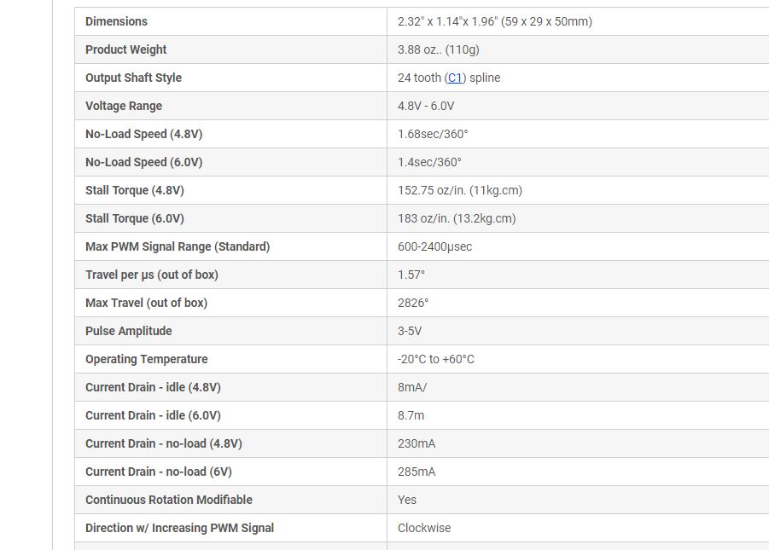
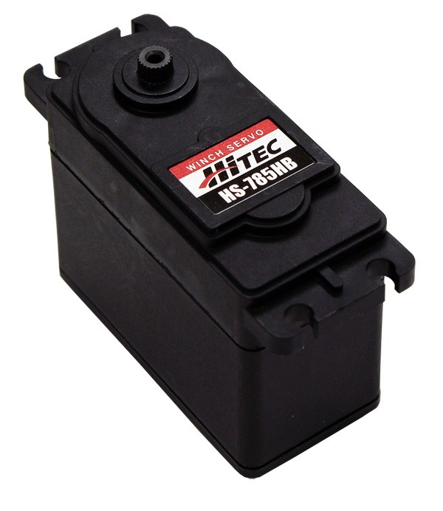
Base Servo
David Koblah
Servo City [2]

Slide 9
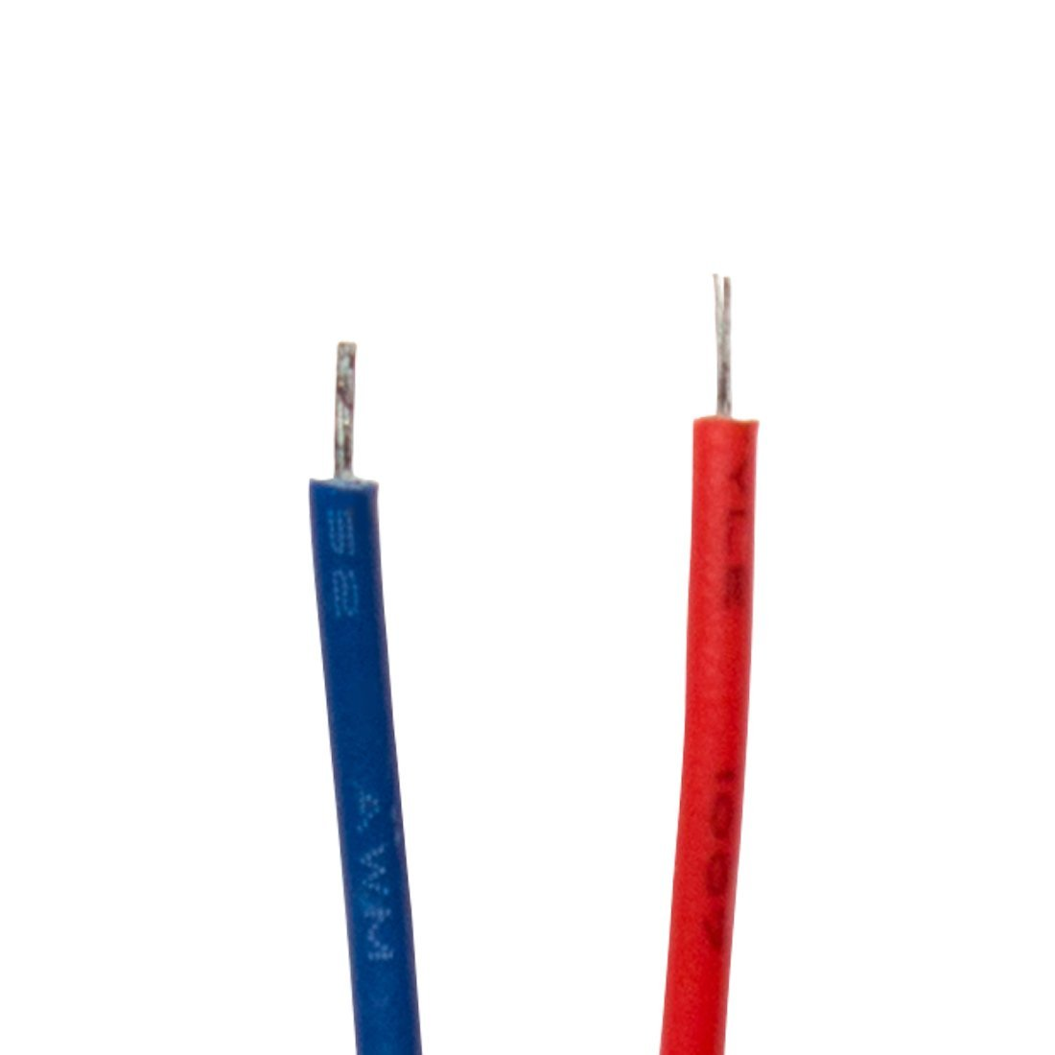
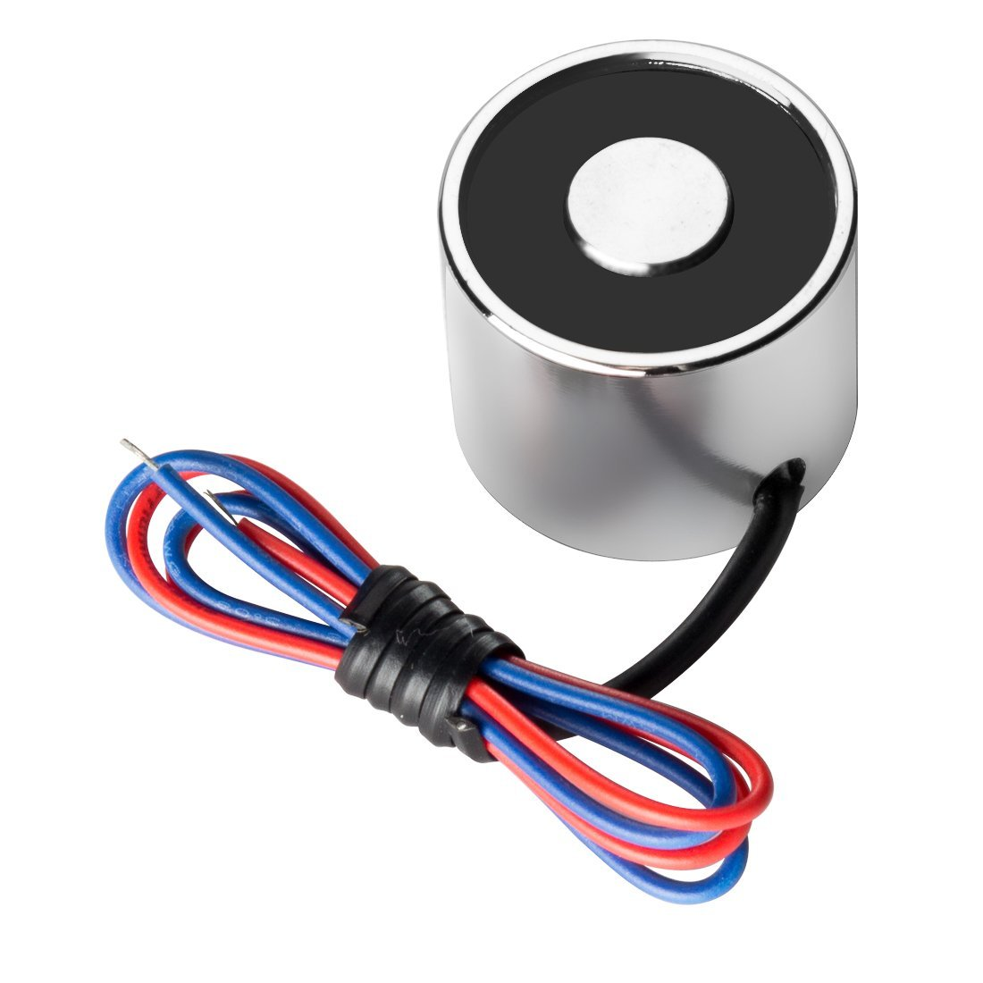
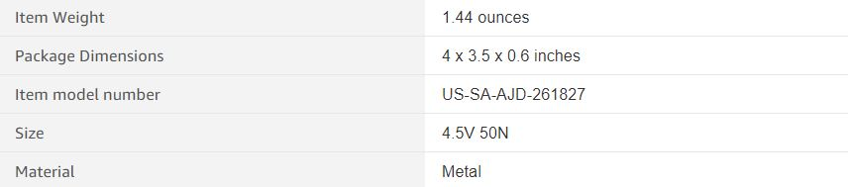
Electromagnet
Negative Lead
Positive Lead
David Koblah
Amazon Prime [3]

Slide 10
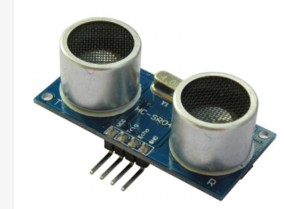
HC-SR04 Ultrasonic Ranging Module
Electro Schematics [4]
Michael Bates

Slide 11
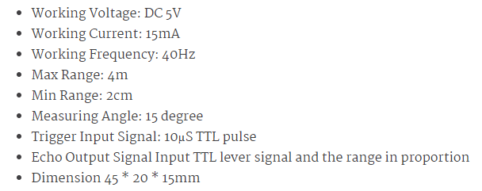
Specifications
Electro Schematics [4]
Michael Bates

Slide 12
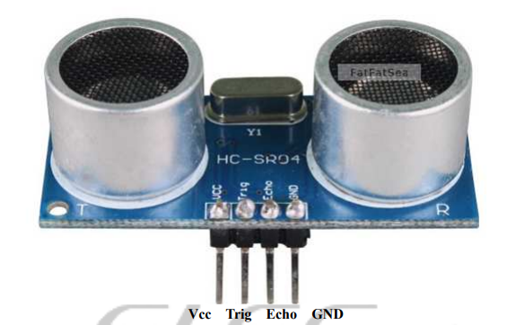
Pinout
Michael Bates
Elec Freaks [5]

Slide 13
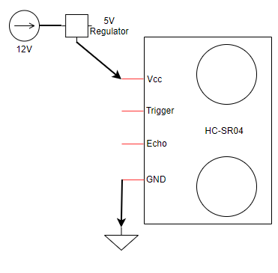
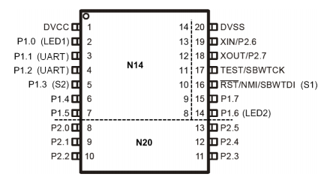
Ultrasonic Interface
Argenox [6]
Michael Bates

Slide 14
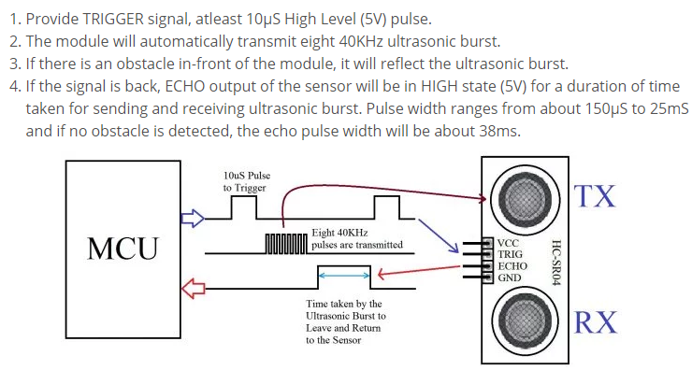
Working of HC-SR04
Michael Bates
electroSome [7]

Slide 15
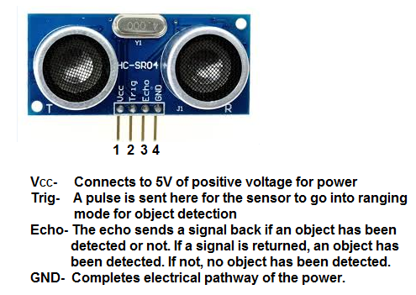
How It Works
Michael Bates
Learning About Electronics [8]

Slide 16
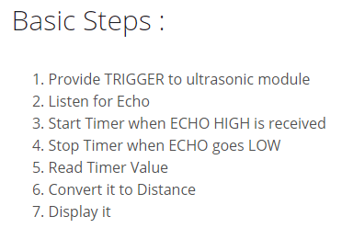
Programming
electroSome [7]
Michael Bates

Slide 17
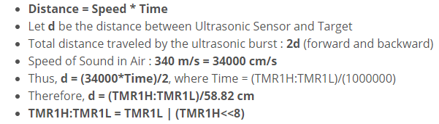
Distance Calculation
electroSome [7]
Michael Bates

Slide 18
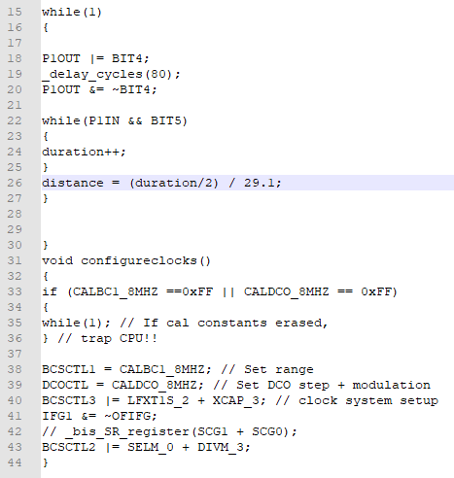
Distance Test Code
Unique distance equation for this code
Texas Instruments [9]
Michael Bates

Slide 19
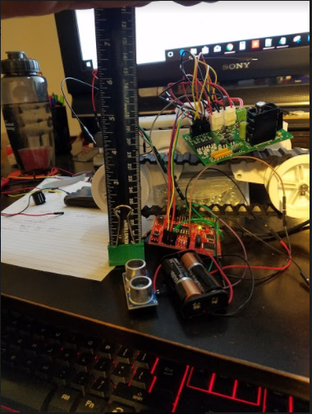
Playing with Distance Test Code
Michael Bates

Slide 20
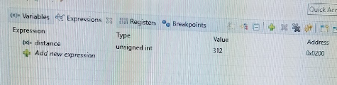
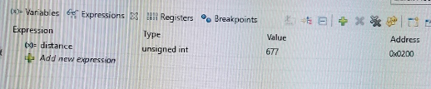

Readings
Michael Bates

Slide 21
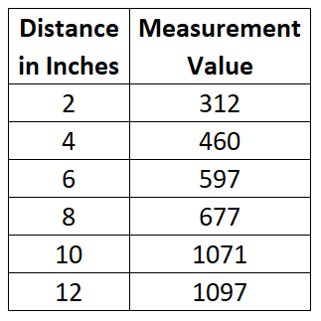
Readings from Example Distance Test Code
Michael Bates

Slide 22

What is a Blob?
Daily Mail [10]
Michael Bates

Slide 23
Definition
BLOB stands for Binary Large Object
Refers to a group of connected pixels in a binary image that share some common property, such as grayscale value.
Blob is also a library for computer vision (cv) to detect connected regions in binary digital images.
OpenCV provides a convenient way to detect blobs and filter them based on different characteristics, such as color.
Blob detection is a fast and simple method that can be used for many machine vision tasks, such as tracking a red ball or finding a blue marker.
OpenCV [11] and Learn OpenCV [12]
Michael Bates

Slide 24
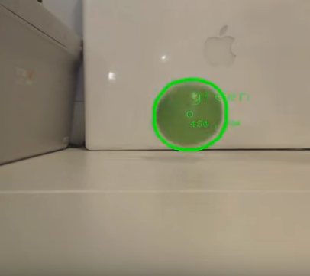
What Can OpenCV Blob Detection Do?
Michael Bates
Youtube [13]

Slide 25
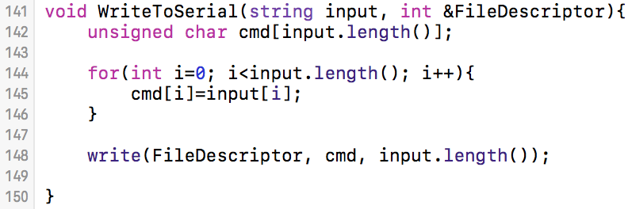
Writing to the Blue SMiRF
Converts String to char array for buffer sending
Integer Location Input Buffer Bytes to send
Jeremiah McCutcheon
[14] StackOverflow: Ajay

Slide 26
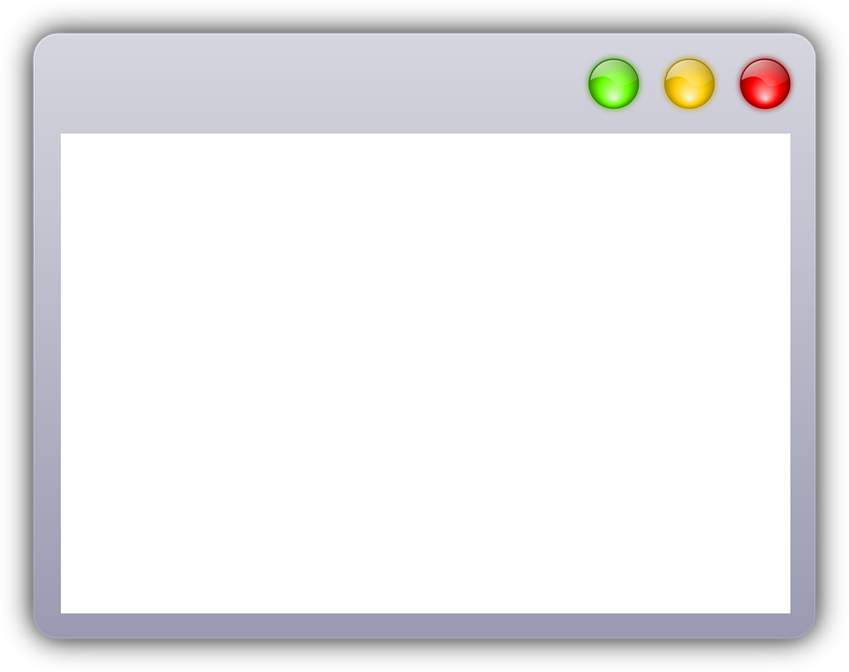

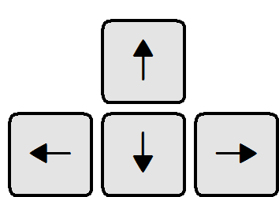
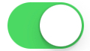
Simple Directmedia Layer
Allows for simple GUI creation (Game Oriented)
Implements cross platform keystroke detection
Widely used for C++ game development
Manual
Live Console/ Feedback data
Jeremiah McCutcheon
[15] LibSDL.org

Slide 27
Flags
Ball Bearing
Styrofoam ball
Blue SMiRF
Stacked 3V coin cell batteries
Jeremiah McCutcheon

Slide 28
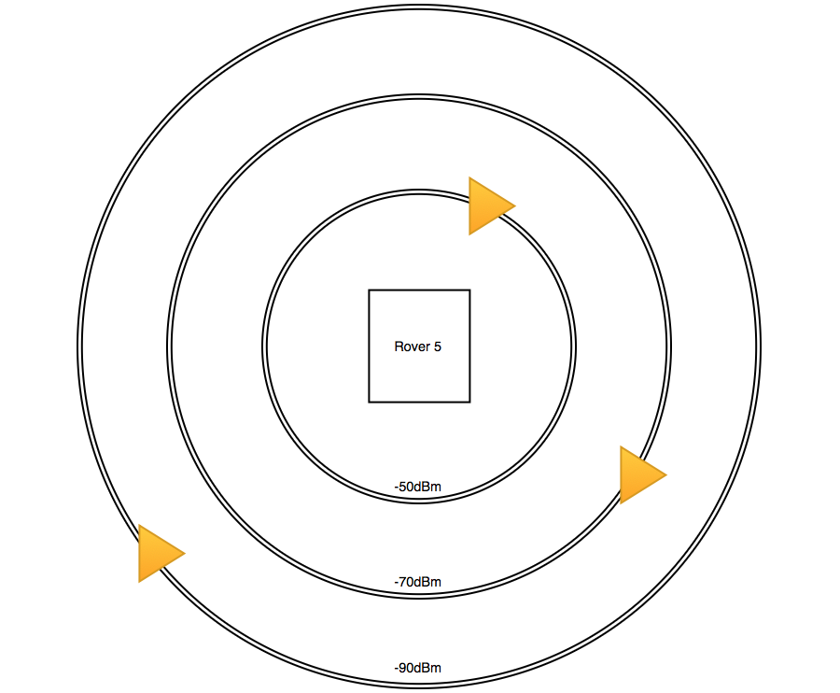
RSSI Flag Location
Issues:
Signal strength is not directly related to distance
RSSI on cheaper Blue SMiRFs may vary without explanation
Jeremiah McCutcheon
[16] MetaGeek

Slide 29
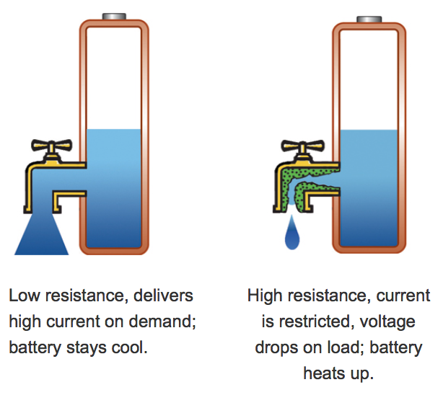
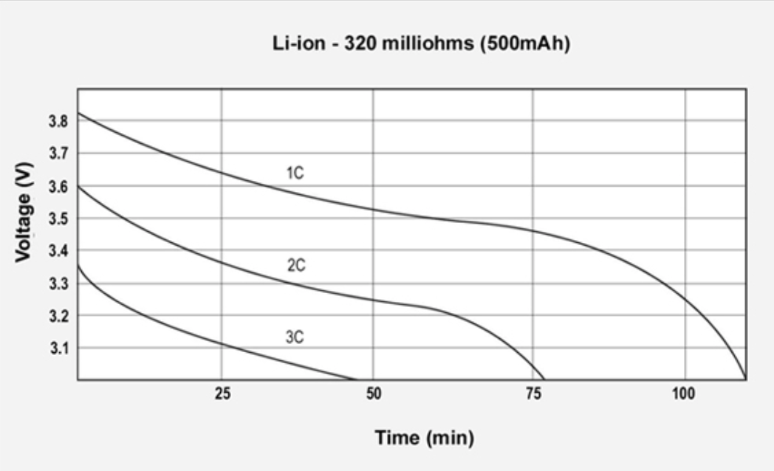
Battery Internal Resistance
Jeremiah McCutcheon
[17] Rising internal resistance: BatteryUniversity.com

Slide 30
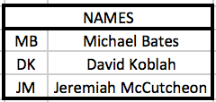
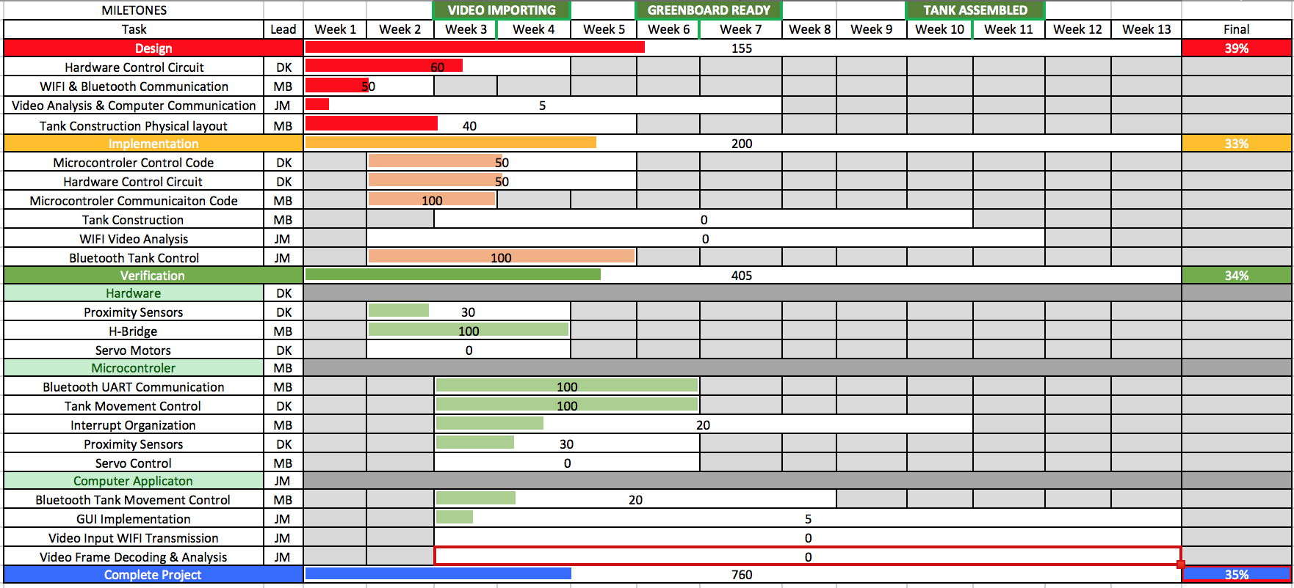
Gantt Chart
Jeremiah McCutcheon

Slide 31
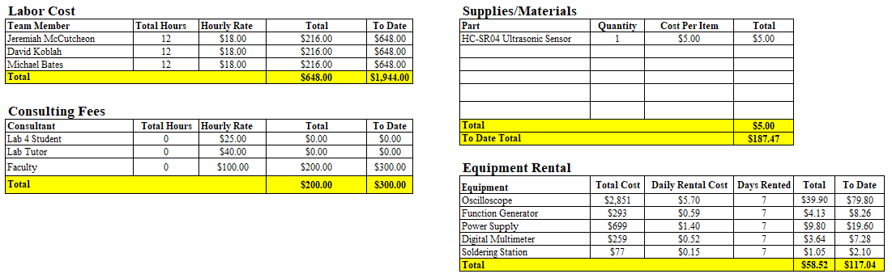
Budget
Michael Bates

Slide 32
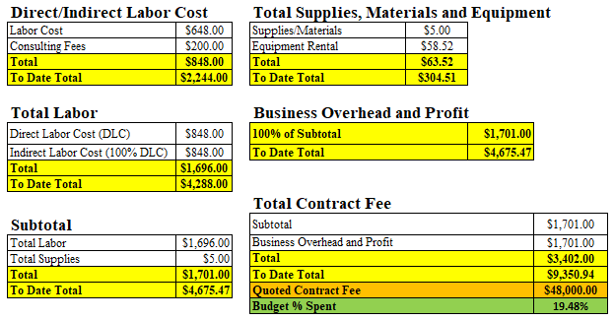
Budget Continued
Michael Bates

Slide 33
Next Week’s Deliverables
Jeremiah
Prototype C++ GUI
Begin IP camera integration
Begin ‘blob identification’ code
David
Order parts and begin construction of robot arm
Produce sample images to begin analysis
Michael
Complete IR Sensor interface
Begin Ultrasonic Sensor interface
Continue Researching Image Processing
David Koblah

Slide 34
References
[1]Robot Shop https://www.robotshop.com/blog/en/robot-arm-torque-tutorial-7152
[2] Servo City https://www.servocity.com/hs-785hb-servo
[3] Amazon Prime, https://www.amazon.com/dp/B01NCVII18/ref=sspa_dk_detail_0?pd_rd_i=B01NBU1YTD&pd_rd_wg=6zO3b&pd_rd_r=C80ZZJM6PHGSEAYPVX5X&pd_rd_w=RySnm&th=1
[4] Electro Schematics, HC-SR04 Datasheet, http://www.electroschematics.com/8902/hc-sr04-datasheet/
[5] Elec Freaks, HC-SR04 Datasheet, https://cdn.sparkfun.com/datasheets/Sensors/Proximity/HCSR04.pdf
[6] Argenox, MSP430 General Purpose Input Output (GPIO), http://www.argenox.com/library/msp430/general-purpose-input-output-gpio-chapter-5/
[7] electroSome, Interfacing HC-SR04 Ultrasonic Sensor with PIC Microcontroller, https://electrosome.com/hc-sr04-ultrasonic-sensor-pic/

Slide 35
References Continued
[8] Learning About Electronics, How To Build a HC-SR04 Distance Sensor Circuit, http://www.learningaboutelectronics.com/Articles/HC-SR04-ultrasonic-distance-sensor-circuit.php
[9] Texas Instruments, https://e2e.ti.com/support/microcontrollers/msp430/f/166/t/316669
[10] Dailymail.com, Exposed: How a shadowy network funded by foreign millions is making our household energy bills soar, http://www.dailymail.co.uk/news/article-2807849/EXPOSED-shadowy-network-funded-foreign-millions-making-household-energy-bills-soar-low-carbon-Britain.html
[11] OpenCV, What exactly is a Blob in OpenCV?, http://answers.opencv.org/question/50025/what-exactly-is-a-blob-in-opencv/
[12] Learn OpenCV, Blob Detection Using OpenCV, https://www.learnopencv.com/blob-detection-using-opencv-python-c/
[13] Youtube, Multiple Object Detection with Color Using OpenCV, https://www.youtube.com/watch?v=hQ-bpfdWQh8

Slide 36
References Continued
[14] StackOverflow: Open a serial port with arduino using C++ with Xcode on mac: Ajay, https://stackoverflow.com/questions/27609972/open-a-serial-port-with-arduino-using-c-with-xcode-on-mac
[15] SDL2: https://www.libsdl.org
[16] MetaGeek Understanding RSSI levels: https://www.metageek.com/training/resources/understanding-rssi.html
[17] Rising internal resistance: http://batteryuniversity.com/learn/article/rising_internal_resistance

Slide 37
Questions?

